Slide 1
Pengenalan CLIPS
Masayu Leylia Khodra
Departemen Teknik Informatika
Institut Teknologi Bandung

Slide 2
Apa itu CLIPS ?
C Language Integrated Production System
C-based expert system tool
Freeware, a tool/development environment for building expert systems
Developed by NASA 1984, released 1986. Version: 6.2 (2008)
Written in C, syntax LISP-like
  LISP: base-language for expert system software tools at that time
Notes:
The word shell is reserved for that portion of CLIPS which performs
inferences or reasoning.

Slide 3
Mengapa Menggunakan CLIPS ?
Perubahan aturan sistem tidak mengubah program, tetapi cukup pengetahuannya.
Dapat diintegrasi dgn aplikasi bahasa lain
  CLIPS Win32 DLL
  ODBC interface for CLIPS
  Bahasa: C, Fortran, ADA, Delphi, Perl, Java
Khusus untuk aplikasi bahasa C
  Embedded in any C application
  External C function dapat dipanggil oleh CLIPS

Slide 4
CLIPS Pada Real World
NASA, uses it in a number of projects in the following domains:
  intelligent computer aided crew training
  weather forecasting
  shuttle space planning
  shuttle diagnostics
  Mission Control Center - telemetry data analysis and diagnostics
  flight assistance and control
  Many others related to the diagnostics

Slide 5
CLIPS Pada Real World (2)
Other companies that successfully use CLIPS:
  MCI Telecommunications
  Cray research - CLIPS will be a cornerstone for Cray III maintenance and diagnostic system
  Fujitsu Network Communications (simulation software)
  Mannesmann Mobilfunk, Germany (mobile communication) - for fault management alarm-correlation and root-cause-analysis (prototype)
Referensi lain: CLIPS Application Abstract (abstract.pdf)

Slide 6
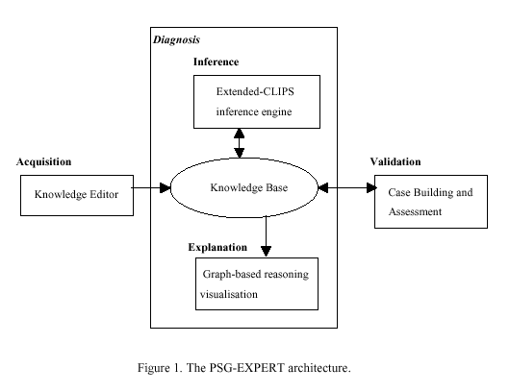
Penggunaan CLIPS
Sumber: A. Fred, J. Filipe, M. Partinen, T.Paiva, "PSG-Expert: An Expert System for the Diagnosis of
Sleep Disorders". In European Neurological Network, T. Paiva and T. Penzel (Eds), IOS Press, no
78, series Studies in Health Technology and Informatics, pp 127-147, 2000.

Slide 7
Interaksi dengan CLIPS
CLIPS command prompt (Top Level Command)
  Commands may be function calls, constructs, global variables, or constants.
  Function calls in CLIPS use a prefix notation
Automated Command Entry and Loading
  automatically execute a series of commands read directly from a file or to load constructs from a file.
Integration with Other Languages

Slide 8
Komponen Dasar SBP - CLIPS
Basis pengetahuan (BP):
  fact-list
    simple ("string") fact
    templates - advanced fact representation
  rule-base
    contains all the rules: if-then rules ("productions")
  instance-list
    objects and instances
inference engine:
  Controls overall execution of rules

Slide 9
Mesin Inferensi CLIPS
standard forward-chaining pattern-matching algorithm (data-driven)
  Mulai dari basis pengetahuan, cocokkan fakta (dan instance) dengan rule, rule yang diaktivasi akan menghasilkan fakta (dan instance) baru, tambahkan fakta (dan instance) baru ke basis pengetahuan, lanjutkan proses sampai goal tercapai (atau tidak ada lagi rule yang dipenuhi)
Pattern matching:
  one-to-one matching
    (ambilSKS ?nama ?mk)
    (ambilSKS Ali IF1281)
conflict resolution: by salience, by order.
Notes:
CLIPS mengatur aktivasi di agenda berdasarkan prioritas yang dimiliki rules dengan salience. Semakin besar nilai salience, semakin besar prioritasnya. Jika nilai salience tidak dideklarasikan, CLIPS meng-assign nilai 0 sebagai default.
CLIPS juga menyediakan command halt untuk menghentikan eksekusi inferensi (loop sampai tidak ada rules yang dipenuhi). Contoh penggunaan fasilitas ini adalah jika kita tidak ingin CLIPS menampilkan semua jawaban yang dihasilkan.
Rule yang mengandung command ini seharusnya dideklarasikan dengan prioritas tinggi.
Forward chaining is a means of utilizing a set of condition-action rules. In this mode of operation, a rule-based system is data-driven. We use the data to decide which rules can fire, then we fire one of those rules, which may add to the data in working memory and then we repeat this process until we (hopefully) establish a conclusion.
The match-resolve-act cycle is the algorithm performed by a forward-chaining inference engine. It can be expressed as follows:
loop
1. match all condition parts of condition-action rules
against working memory and collect all the rules that match;
2. if more than one match, resolve which to use;
3. perform the action for the chosen rule
until action is STOP or no conditions match
Mesin inferensi
A rule-based system requires some kind of program to manipulate the rules - for example to decide which ones are ready to fire. (i.e. which ones have conditions that match the contents of working memory). The program that does this is called an inference engine, because in many rule-based systems, the task of the system is to infer something, e.g. a diagnosis, from the data using the rules.
conflict resolution
Conflict resolution in a forward-chaining inference engine decides which of several rules that could be fired (because their condition part matches the contents of working memory should actually be fired. Conflict resolution proceeds by sorting the rules into some order, and then using the rule that is first in that particular ordering. There are quite a number of possible orderings that could be used:
Specificity Ordering
If a rule's condition part is a superset of another, use the first rule since it is more specialised for the current task.
Rule Ordering
Choose the first rule in the text, ordered top-to-bottom.
Data Ordering
Arrange the data in a priority list. Choose the rule that applies to data that have the highest priority.
Size Ordering
Choose the rule that has the largest number of conditions.
Recency Ordering
The most recently used rule has highest priority. The least recently used rule has highest priority. The most recently used datum has highest priority. The least recently used datum has highest priority
Context Limiting
Reduce the likelihood of conflict by separating the rules into groups, only some of which are active at any one time. Have a procedure that activates and deactivates groups.

Slide 10
Fakta
Sintaks: LISP-like
First order predicate logic
F: Ali adalah seorang mahasiswa
  CLIPS: (mahasiswa Ali)
F: Ali mengambil kuliah IF1281
  CLIPS: (ambilKuliah Ali IF1281)
Case-sensitive:
  (mahasiswa Ali) ≠ (mahasiswa ali)
Notes:
First-order predicate logic
Second-order predicate logic
Third-order predicate logic

Slide 11
Fakta (2)
Memasukkan fakta ke dalam BP:
(assert <predicate-logic>)
  CLIPS>(assert (mahasiswa Ali))
  CLIPS>(assert (ambilKuliah Ali))
Memasukkan sekumpulan fakta ke dalam BP:
  (deffacts <deffacts-name> [<comment>] <predicate-logic>*)
  (deffacts data-Ali
  (mahasiswa Ali)
  (ambilSKS Ali 18)
  (ambilKuliah Ali IF1281))
Catatan:
  Sebelum fakta dimasukkan dgn assert, eksekusi dulu command (reset), cukup sekali di awal.
  Command deffacts akan dieksekusi setelah command (reset) dipanggil.

Slide 12
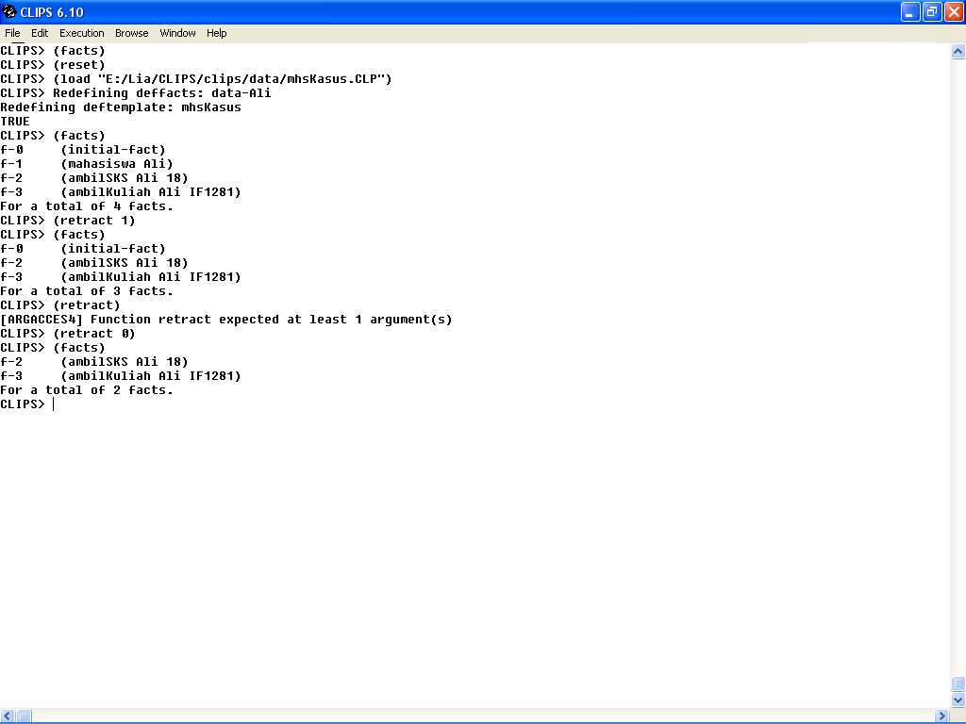
Fakta (3)
Menampilkan fakta: (facts)
Menghapus fakta
(retract <retract-specifier>+)
  CLIPS>(retract 1)

Slide 13
Template Fakta
Template: advanced fact representation
Pengaksesan berdasarkan nama field/slot
(deftemplate <deftemplate-name> [<comment>]
<slot-definition>*)
(deftemplate mhsKasus
(slot nama (type STRING))
(slot sksBlmLulusGenap (type INTEGER))
(slot sksBlmLulusGanjil (type INTEGER))
(slot sksAmbil (type INTEGER))
(slot IP (type FLOAT))
(slot statusTA (type SYMBOL)))

Slide 14
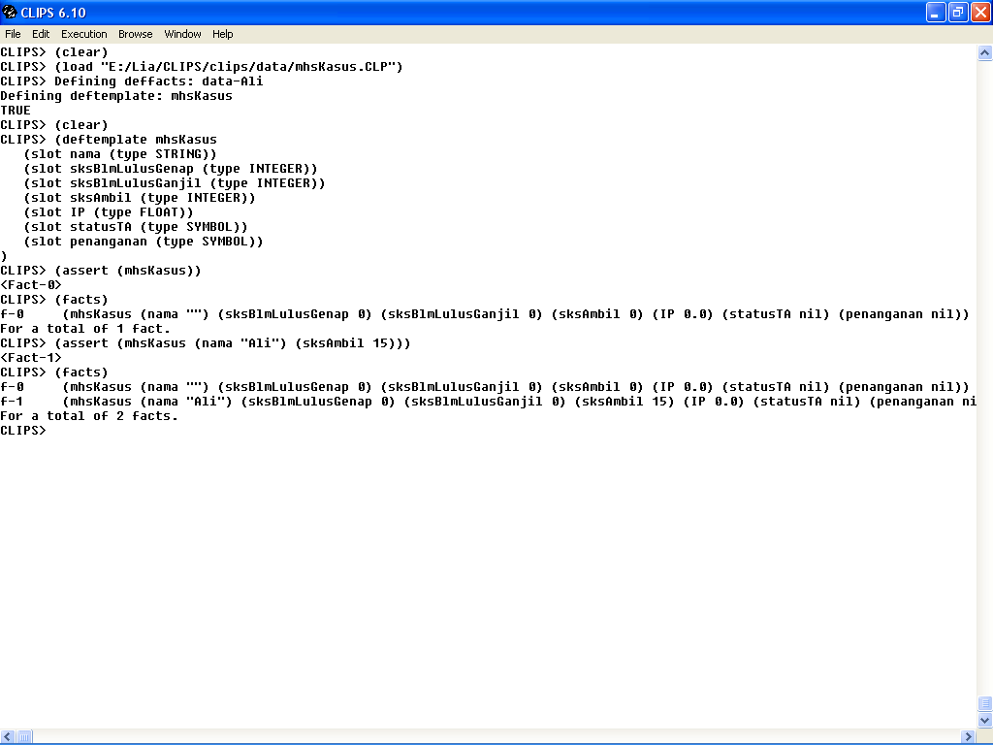
Template Fakta (2)
Notes:
Pengaksesan data berdasarkan nama field.

Slide 15
Template Fakta (3)

Slide 16
Production Rules
(defrule <rule-name> [<comment>]
[<declaration>]
<conditional-element>*
=>
<action>*)
(defrule mhsAktif
(mahasiswa Ali)
(ambilKuliah Ali IF1281)
=>
(printout t "Ali mahasiswa aktif" crlf))
Notes:
Rule component:
rule header
defrule keyword, name of the rule, optional comment string
rule antecedent (LHS)
patterns to be matched against facts
rule arrow
separates antecedent and consequent
rule consequent (RHS)
actions to be performed when the rule fires

Slide 17
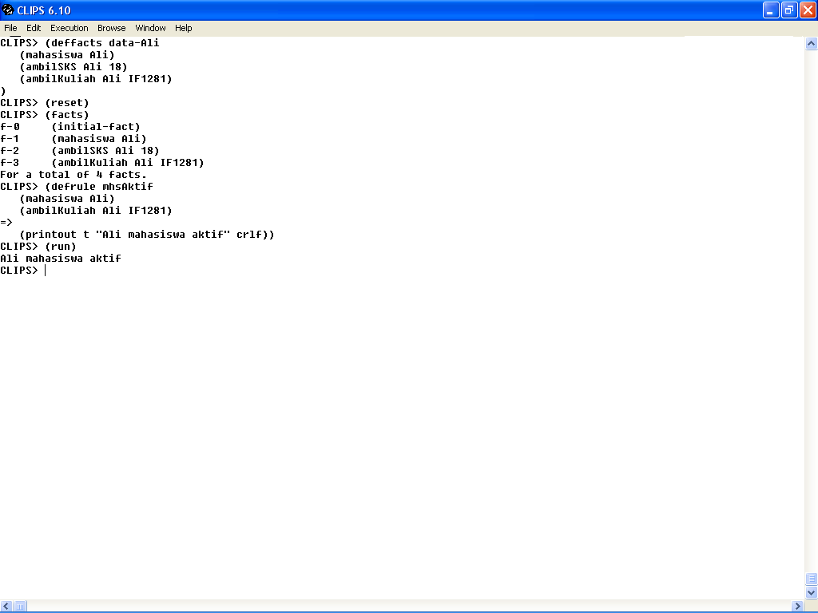
Production Rules (2)

Slide 18
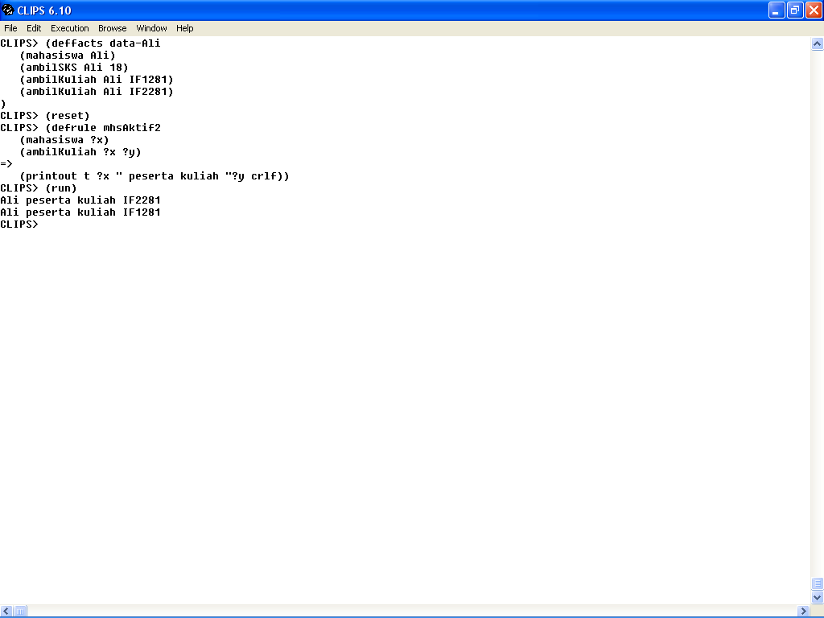
Production Rules (3)
Penggunaan variabel dalam rule: ?<nama>

Slide 19
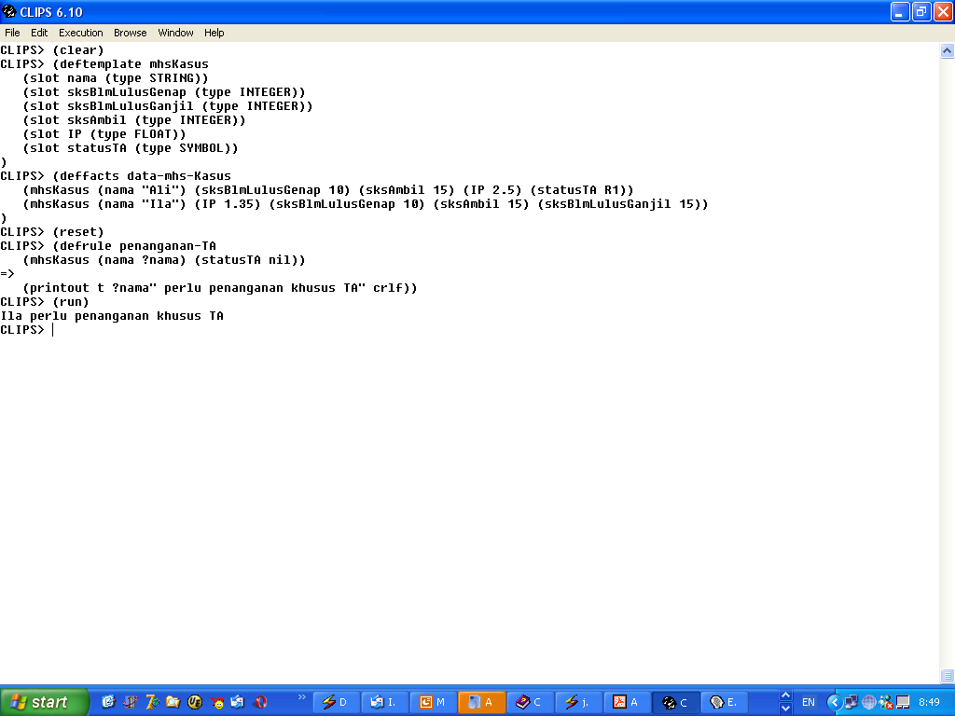
Production Rules (4)
Penggunaan variabel dan pengaksesan template dalam rule

Slide 20
Paradigma Pemrograman CLIPS
Rule-based programming:
  allows knowledge to be represented as heuristics, or "rules of thumb," which specify a set of actions to be performed for a given situation.
Object-oriented programming:
  allows complex systems to be modeled as modular components (which can be easily reused to model other systems or to create new components).
procedural programming:
  capabilities provided by CLIPS are similar to capabilities found in languages such as C, Java, Ada, and LISP.

